Slide 1
Circular Economy Engineering Case Study
Recycling laboratory & medical equipment for a surplus asset management company

Slide 2
Laboratory & Medical Equipment Recycling
Background and Challenge
The Solution At a Glance…
It starts with a collection request done by the customer directly to the single point of contact.
The service consists of collection carried out in direct shipment from the collection point to the recycling facilities. The recycling facilities are selected from the activated and qualified end-of-life H2 Compliance and according to the proximity principle.
The equipment is properly stacked in standard-sized pallets and packed in such a way as to prevent breakage, damage, contamination, and harmful effects on human health or the environment during transport. On the agreed date, the material is loaded onto the truck.
Upon the arrival at the recycling facility, the unloading, weighing, and recycling process is executed.
Certificate of recycling and serial number report provided to customer after completion of project.
The customer wanted to recycler surplus laboratory and medical equipment for its clients throughout the United States and Canada.
Due to the unique characteristics of the devices (size, weight, etc.) and the large client service area, the customer requested H2 Compliance to design a solution that could be easily scalable and flexible.
Customer Profile
Surplus asset management company for laboratory and medical equipment owners.
Objectives
Set up a program to package, transport, and recycle end-of-life laboratory and medical equipment for client customers throughout the United States and Canada.
Smooth pick-up process.
Short lead-time (from pick-up requests to the actual request).
Single point of contact for North American takeback operations.
For more information about the product please access our product sheet available at:
Laboratory & Medical Equipment Recycling

Slide 3
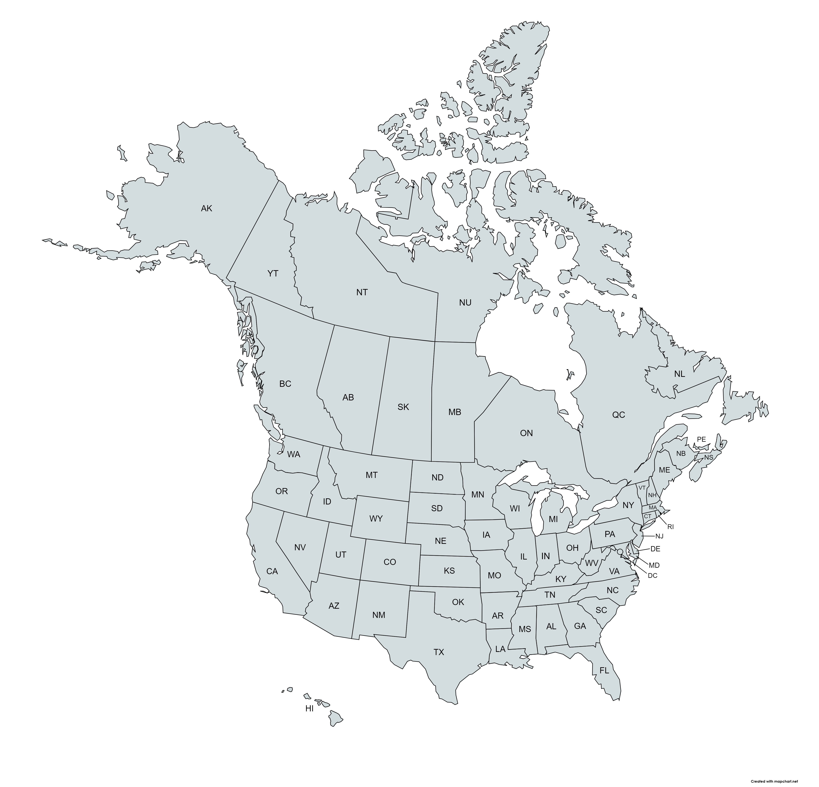
Laboratory & Medical Equipment Recycling
Key Facts/Results
01
Lead time (from pick-ups request to actual pick-up) on average of 3 days and no more that 5 days.
02
Multi-company logistics network servicing all client locations throughout the United States and Canada. Complete white-glove service, including packaging, loading, etc., at the client location.
03
Two recyclers with 13 locations across the United States and Canada.
04
Recycling completed within 30 days of asset retrieval accompanied with recycling proof.

