Slide 1
Circular Economy Engineering Case Study Mail-Back
Managing a product mail-back program for a large electronics OEM

Slide 2
Secure Destruction
Managing a product mail-back program for a large electronics OEM
Background and Challenge
The Solution At a Glance…
SUPPLY CHAIN DESIGN
Selection/Activation of an EoL supply chain (logistics and treatment of electronic products).
Traceability of downstream network for materials of concern up to final disposition.
SUPPLY CHAIN QUALIFICATION
Ability to accept and recycle OEM products delivered in different volumes from all regions of the United States and Canada at certified recycling facilities.
MAIL-BACK OPERATIONS
Creation and operation of an OEM-specific website to provide a secure portal for customers to submit mail-back requests.
Implementation of the logistics and treatment operations (delivery, recycling, and reporting).
REGULATORY REQUIREMENTS
Description of mail-back program and operation instructions reported to consumers and state governments as required.
The customer needed to setup and operate a product mail-back program to comply with the regulatory requirements of several states and provinces within the United States and Canada. The program had to be available to consumers located in every region of the country. To accomplish this goal, they requested that H2 Compliance design a solution that could be easily scalable and flexible.
Customer Profile
Multi-national original equipment manufacturer (OEM) of personal electronics.
Objectives
Set up a multi-state product mail-back program to comply with the regulatory requirements of several states and provinces in the US and Canada.
Operate the mail-back program on behalf of the OEM to ensure compliance with requirements.
For more information about the product please access our product sheet available at:
Mail-Back
FORM.HH.058 (Circular Economy Engineering Case Study)

Slide 3
Secure Destruction
Managing a product mail-back program for a large electronics OEM
Background and Challenge
The Solution At a Glance…
SUPPLY CHAIN DESIGN
Selection/Activation of an EoL supply chain (logistics and treatment of electronic products).
Traceability of downstream network for materials of concern up to final disposition.
SUPPLY CHAIN QUALIFICATION
Ability to accept and recycle OEM products delivered in different volumes from all regions of the United States and Canada at certified recycling facilities.
MAIL-BACK OPERATIONS
Creation and operation of an OEM-specific website to provide a secure portal for customers to submit mail-back requests.
Implementation of the logistics and treatment operations (delivery, recycling, and reporting).
REGULATORY REQUIREMENTS
Description of mail-back program and operation instructions reported to consumers and state governments as required.
The customer needed to setup and operate a product mail-back program to comply with the regulatory requirements of several states and provinces within the United States and Canada. The program had to be available to consumers located in every region of the country. To accomplish this goal, they requested that H2 Compliance design a solution that could be easily scalable and flexible.
Customer Profile
Multi-national original equipment manufacturer (OEM) of personal electronics.
Objectives
Set up a multi-state product mail-back program to comply with the regulatory requirements of several states and provinces in the US and Canada.
Operate the mail-back program on behalf of the OEM to ensure compliance with requirements.
For more information about the product please access our product sheet available at:
Mail-Back

Slide 4
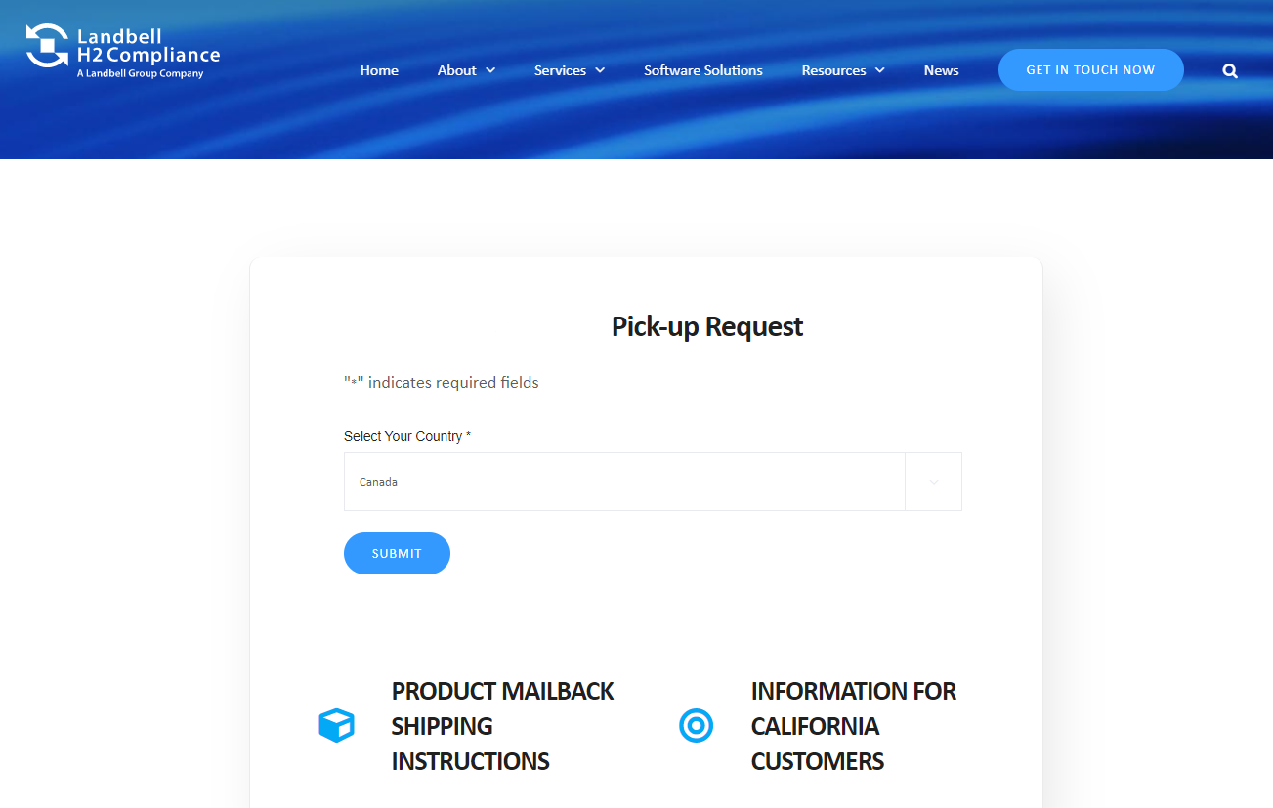
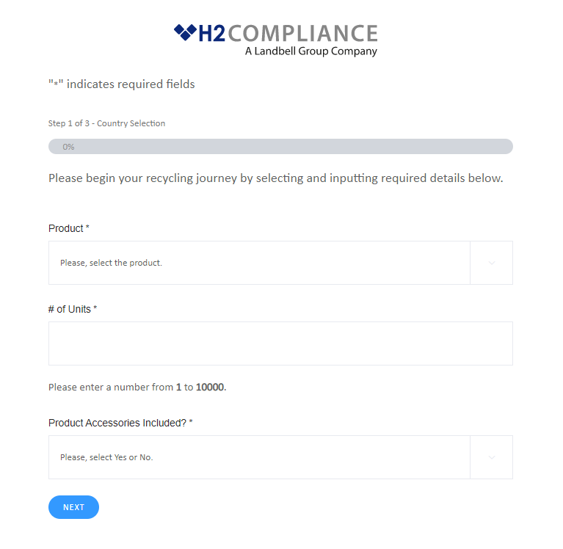
Secure Destruction
Managing a secure product destruction project for a small mobile phone OEM
Key Facts/Results
01
More than 15 years of knowledge and expertise in e-waste take-back with a multi-county network of +300 recyclers
02
Recyclers with the ability to accept deliveries of all sizes from across the US and Canada
03
Creation of web portal to allow OEM customers to enter mail-back requests
04
Partnership with FedEx to deliver electronics to recycler
05
Coordination with governmental agencies to ensure program meets regulatory requirements

